Slide 1

Web Interface for Resend Messages

Slide 2
Home Page for Replay Messages Process

Slide 3

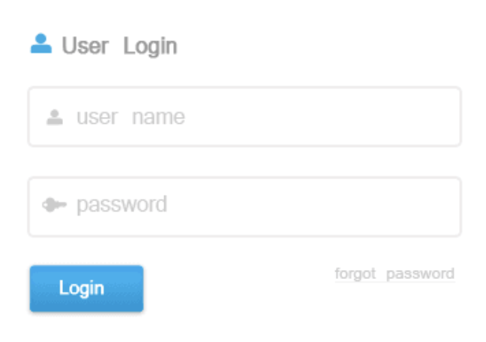
Resend Message

Slide 4
Button Action – Home Page
Login Button
Open “Resend Request” Page
Mule Anypoint
Publish Message to “Registration” Queue
Subscribe Message from “Registration” Queue

Slide 5
“Resend Request” Page

Slide 6



Registration
Request
Requestor Name :
Enter
Quit

Slide 7
Button Action – Registration Request
Enter
Open “Enter Datetime” page
Quit
Just quite the application
Mule Anypoint
Publish Message to “Registration” Queue
Subscribe Message from “Registration” Queue

Slide 8
“Enter Datatime” Page

Slide 9
Enter Date
& Time
Requestor Name :
Send From Date :
Send From Time :
:
Current Replay Queue Count :
9,999
OK
Cancel

Slide 10
Button Action – Enter Datetime
OK
API will Publish a message into “Resend_Request” Queue with fields including Requestor Name , Start From Date, Start From Time
After then, API will subscribe a message from “Resend_Request” Queue and trigger Solace SEMP API to replay messages from Replay Queue to particular customer Replay Queue
Cancel
Just quite the application
Mule Anypoint
Publish Message to “Registration” Queue
Subscribe Message from “Registration” Queue

